Slide 1
Business Problem Understanding.
1. Business Context.
An aviation company providing both domestic and international trips wants to enhance its marketing strategy by shifting from traditional tele-calling to a targeted digital advertising approach. They have collaborated with a company specializing in social networking and digital outreach to identify customers with a high propensity to purchase flight tickets.
2. Key Business Objectives.
•Identify potential customers most likely to book flight tickets in the near future.
•Leverage digital and social media behavior for personalized advertisements.
•Optimize marketing spend by targeting high-intent customers instead of mass outreach.
•Improve profitability by increasing conversion rates.
•Analyze customer behavior, patterns, and interactions with travel-related digital platforms to refine marketing strategies.

Slide 2
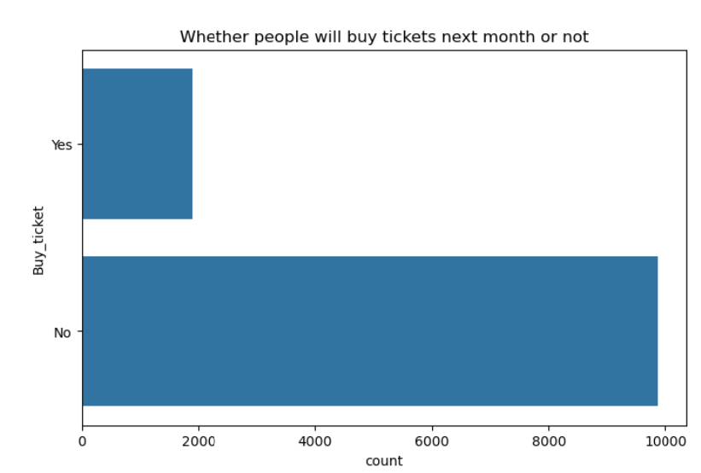
Business Problem Understanding.
3. Business Constraint.
Current strategies are failing, leading to low ticket conversion rates.
The data suggests that the current marketing and engagement strategies are ineffective in driving ticket sales.
This results in wasted marketing efforts and missed revenue opportunities.
Results in limited ROI on marketing campaigns, Inefficient resource allocation and Need for a refined customer targeting strategy.

Slide 3
Modeling Approach and Why?.
The goal is to predict whether a customer is likely to buy a ticket based on their social and digital behavior. The dataset is highly imbalanced, with a majority of customers not purchasing tickets (~85%).
We need balanced data i.e. not skewed in order predict the propensity of customers buying tickets as imbalanced data will give wrong predictions.
In order to do that we can use technique like SMOTE to generate synthetic samples for minority class (‘Yes’ for ‘buy_tickets’ in this case.)
The performance of any model is judged by parameters such as recall, precision ad f1 score.
The best performing model will have optimal values for these parameters compared to the other models.

Slide 4
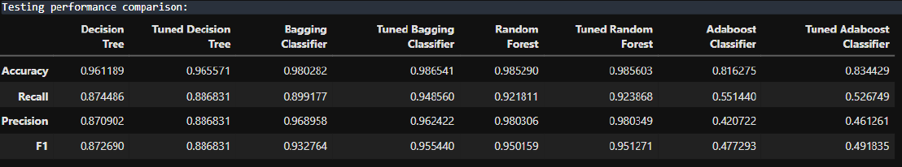
Modeling Approach and Why?.
Thus Tuned Bagging Classifier model is selected for prediction of the target variable. Due to it’s optimal values for Precision, Recall and F1 score.

Slide 5
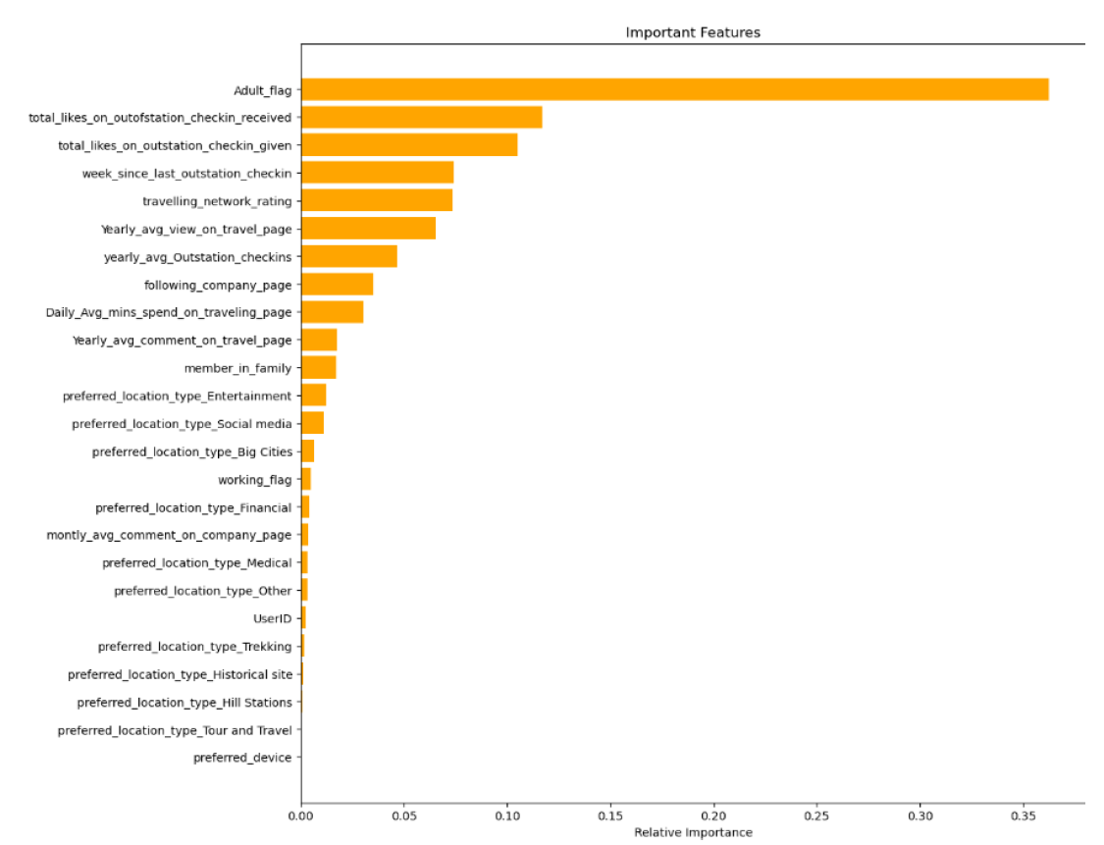
Insights & Recommendations

Slide 6
Insights
High significance for total_likes_on_outstation_checkin_received suggest that receiving likes on outstation check-ins (shared experiences while traveling) correlates strongly with the target variable.
This could imply social popularity or engagement in travel activities, which may be a key determinant.
week_since_last_outstation_checkin suggest the recency of outstation check-ins. Higher importance could mean users with recent check-ins are more likely to exhibit behaviors tied to the target (e.g., loyalty, spending).
Yearly_avg_view_on_travel_page suggests that users frequently viewing travel-related pages are more likely to align with the target behaviour.

Slide 7
Recommendations
Leverage recency data (week_since_last_outstation_checkin) for reactivation strategies.
Send reminders or notifications to users with high week_since_last_outstation_checkin (inactive travellers) to reignite their interest with “We Miss You” campaigns or reactivation incentives.
Users with high total_likes_on_outstation_checkin_received or total_likes_on_outstation_checkin_given are likely influential and engaged. Use loyalty programs, early-bird offers, or exclusive travel deals to retain them. Encourage them to share travel experiences on platforms by offering perks for engagement (e.g., discounts for tagging your brand in posts).
Introduce gamification for features like total_likes_on_outstation_checkin_received and total_likes_on_outstation_checkin_given. For example: Provide badges, milestones, or rewards for users achieving high engagement levels.

